Slide 1
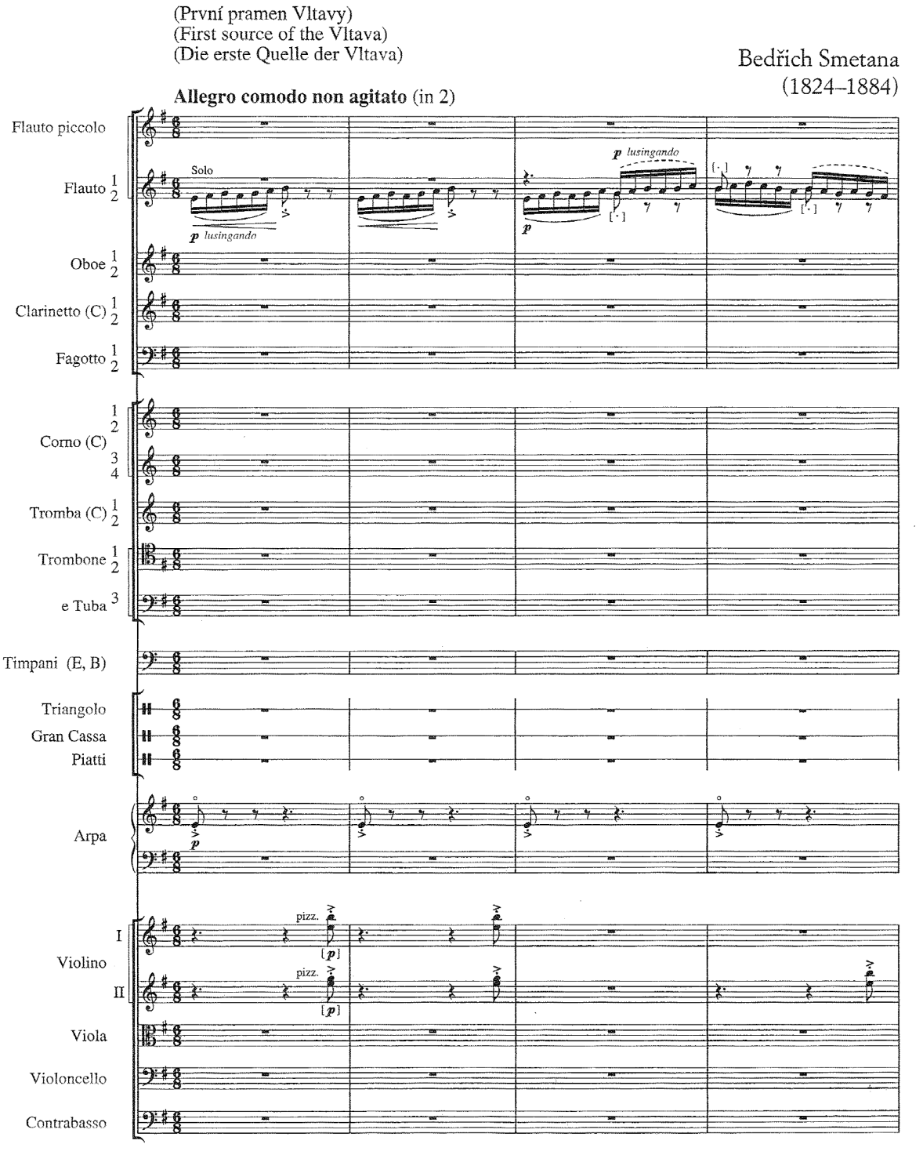
Fastslå besætningen:
Ma Vlast (1874) – mit fædreland
t. 1-40 Moldaus kilder
t. 40-80 Hovedtema
t. 80-118 Jagt i skoven
t. 118-181 Bryllup i landsbyen
t. 181-239 Måneskin – vandnymfernes dans
t. 239-271 Hovedtema
t. 271-333 St. Johann faldene
t. 333-359 Flodens brede strøm
t. 359-437 Vysehrad-motivet

Slide 2
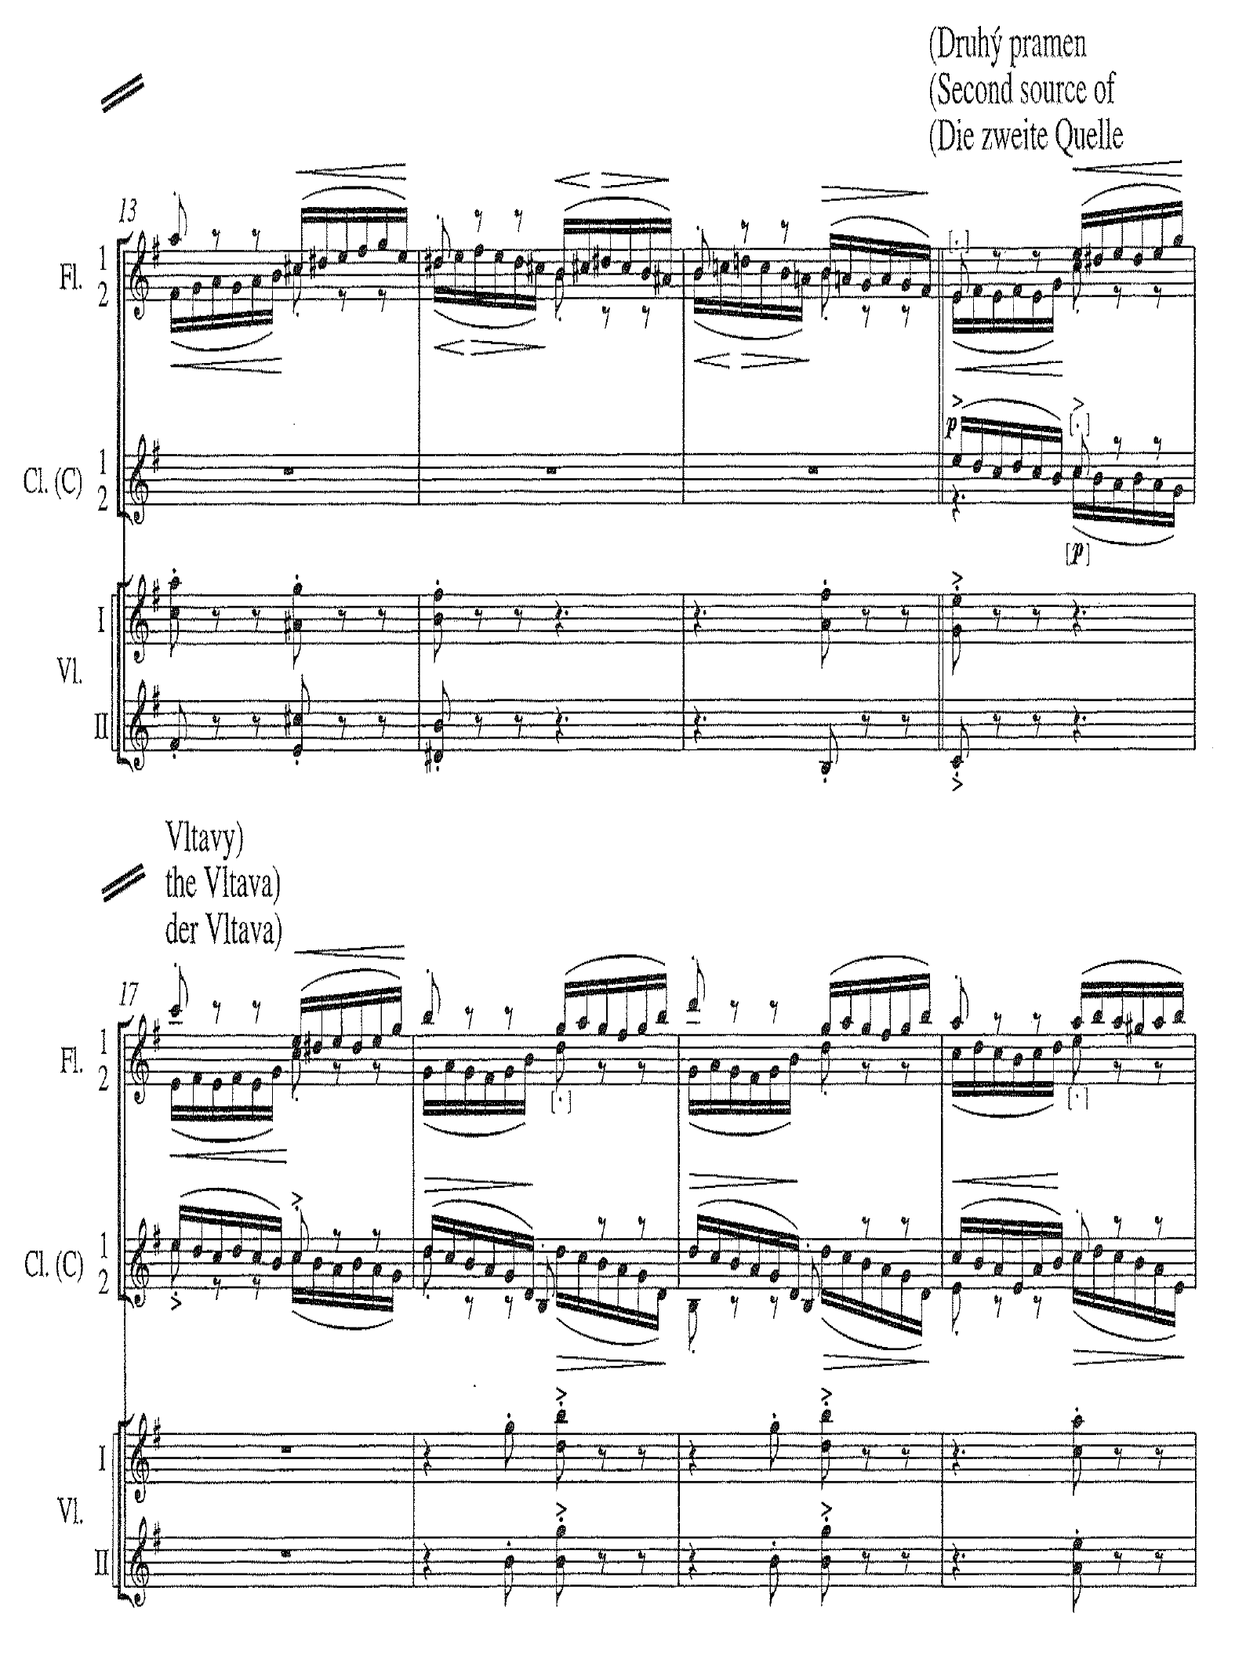
Kilde nr. 2
Satsarbejde og melodisk analyse:
Beskriv arbejdsdelingen mellem instrumenterne
Beskriv konturen af de enkelte motiver og begrund
valget af netop disse melodiformer

Slide 3
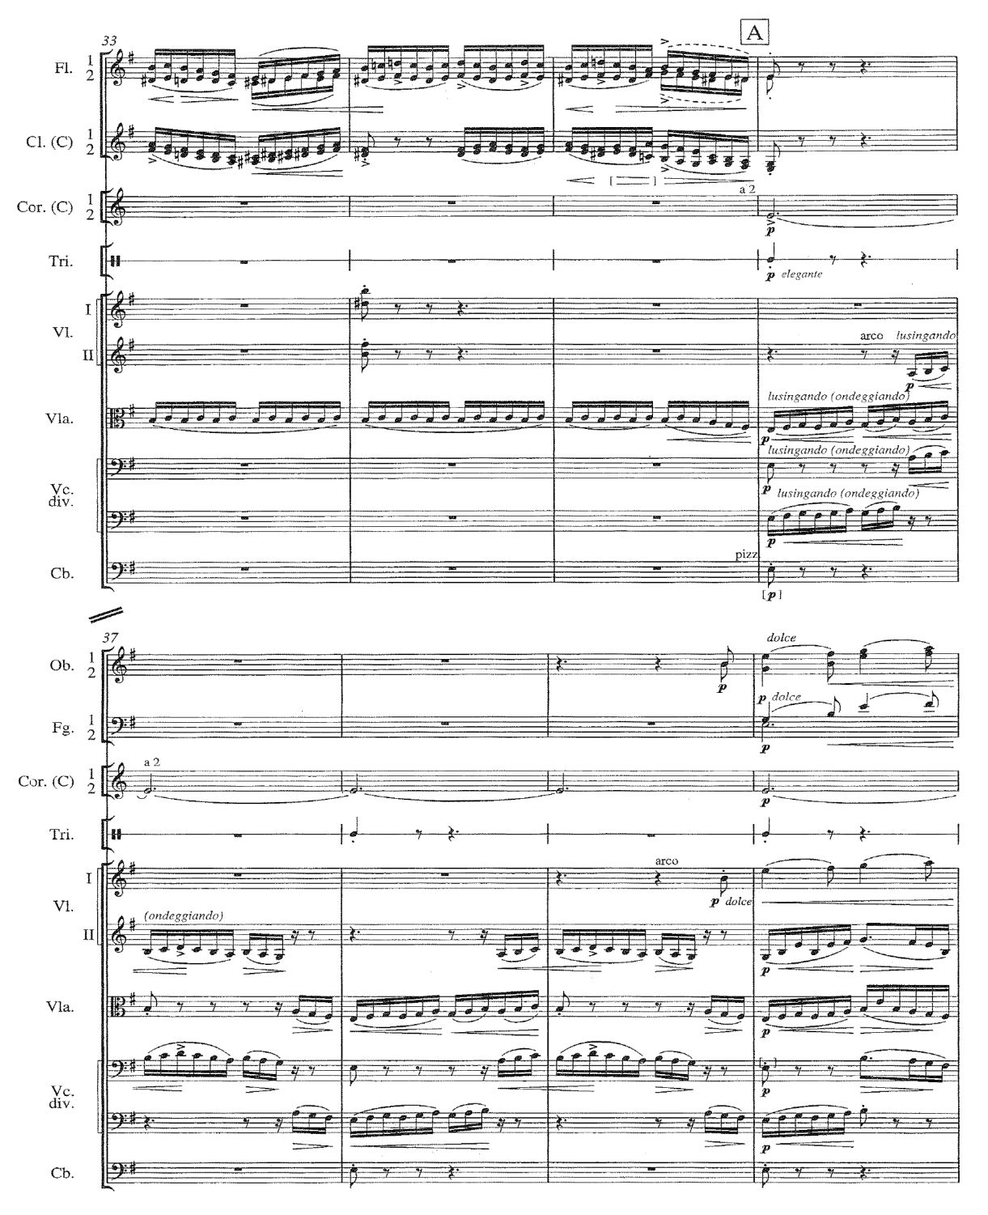
Overgang til hovedtema A
The introductory section, ”The first source
of the Vltava”, that precedes the clear folk-
like theme at letter A is….perhaps the most
exquisite depiction of the natural movement
of water in the orchestral literature.
Eddies swirl and spiral across nearly 40 bars
of flutes and clarinets centered around the
note E almost throughout.
The broad E-minor melody, whose long
sweep in violins and oboes immediately con-
jures a great river in the mind’s eye ensues;
the rippling waters drive on in the lower
strings.
The river painted thus with obvious clarity,
Smethana’s patriotic narrative thread is first
evinced by the woodland hunting scene that
immediately follows.
Bemærk hvordan strygerne overtaget træblæsernes
bølgefigurer………..

Slide 4
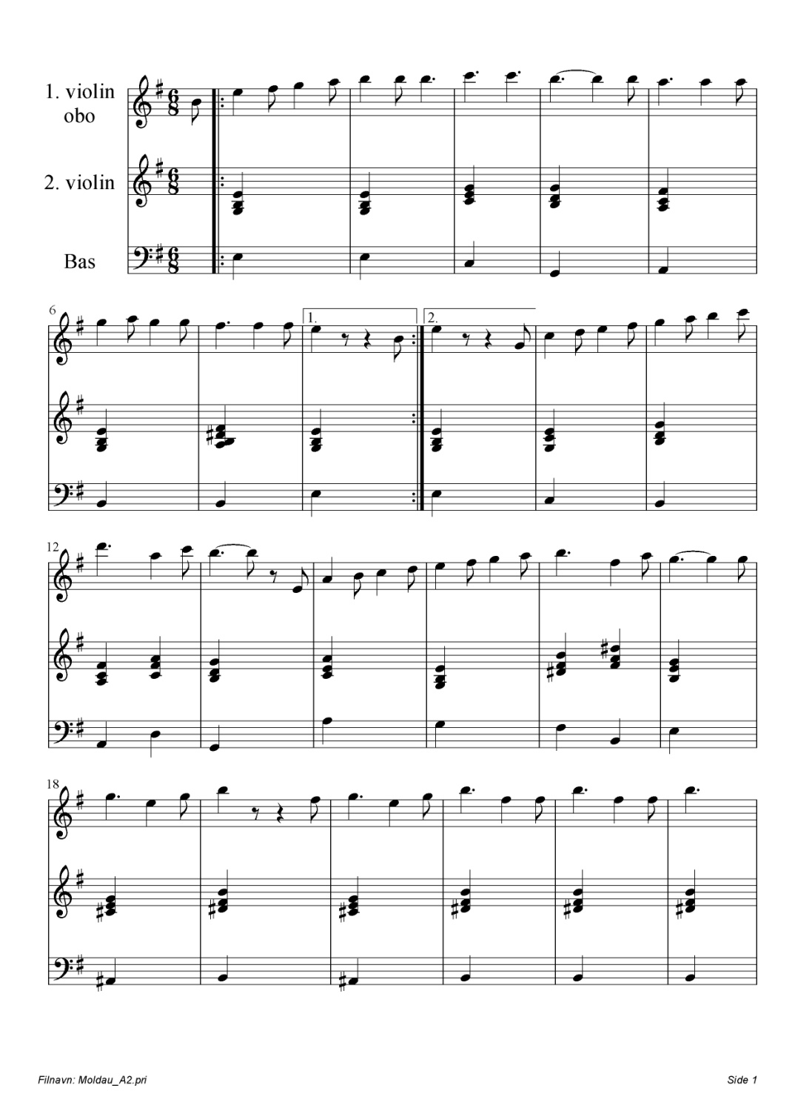
Hovedtema A
Melodi og harmonisk reduktion:
Fastslå tonalitet og foretag melodisk analyse
(tonevalg, frasering, kontur, gentagelsesele-
menter mm.)
Forsyn akkorderne med becifring og
foretag funktionsanalyse
Konkludér på sammenhængen mellem
Melodik og harmonik
Hvad er forskellen på 1. og 3. udgave af temaet?:
1. udgave:
3. udgave :
Hvad er virkningen og hvad kan begrundelsen være?

Slide 5
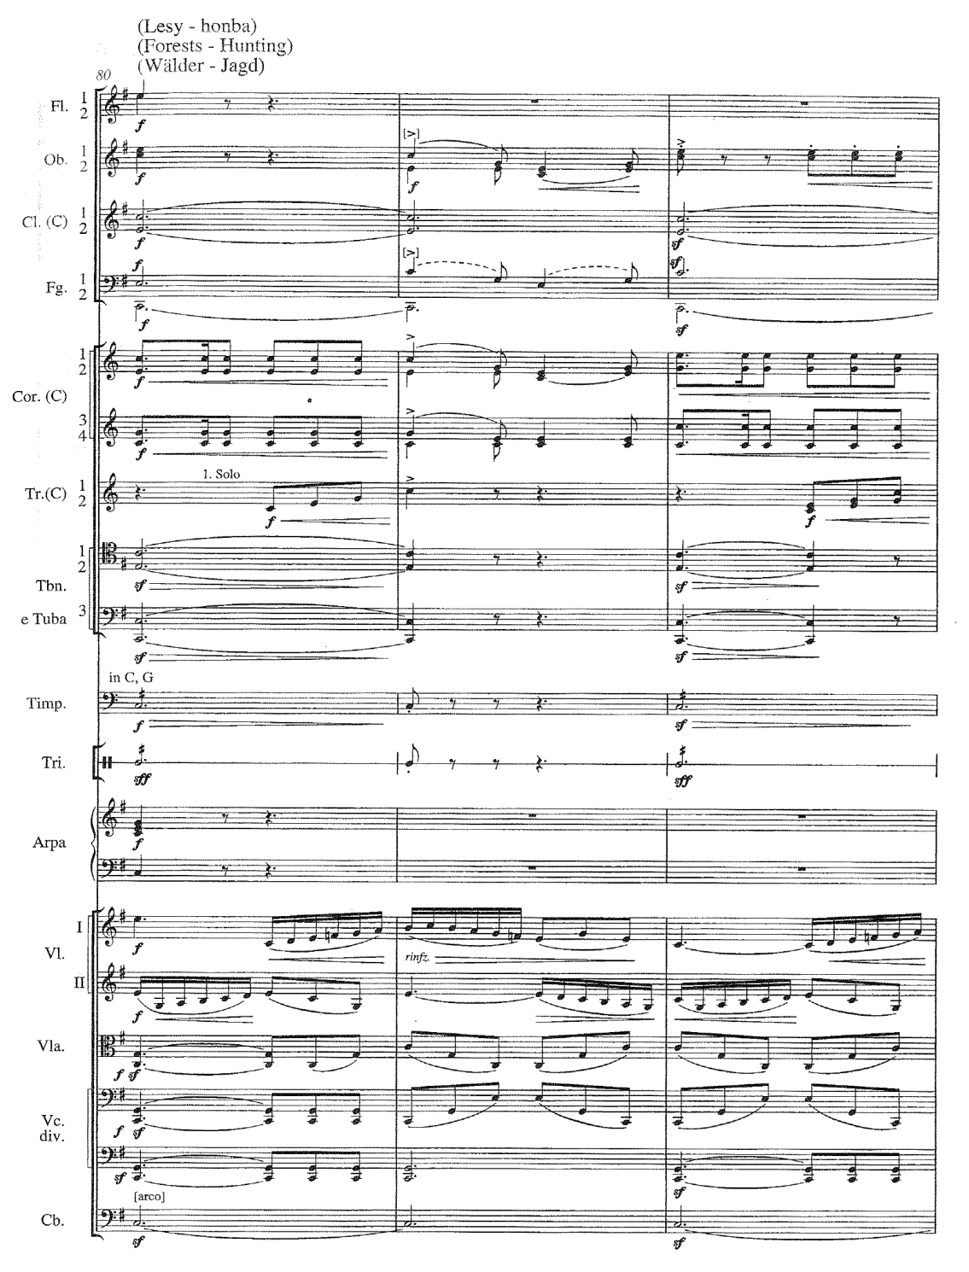
Jagt i skoven
We are clearly no longer being carried along
by the undaunted currents of the Moldau.
Smethana’s adoption of the river more as ”some
great mighty thought threading a dream” – a sym-
bol for life’s or a national continuum, is shown in
the bugle calls and equestrian vaunting in the
strings.
Hvad er de dominerende instrumenter?
Beskriv deres melodiske karakter og begrund
valget af netop denne form for melodik?
Kommenter på den harmoniske udvikling:
C – G7 – F – Dm6 – E - Em
…og på den dynamiske : f – ff – f – p – pp - ppp

Slide 6
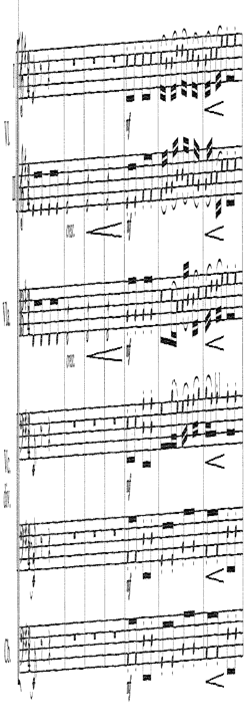
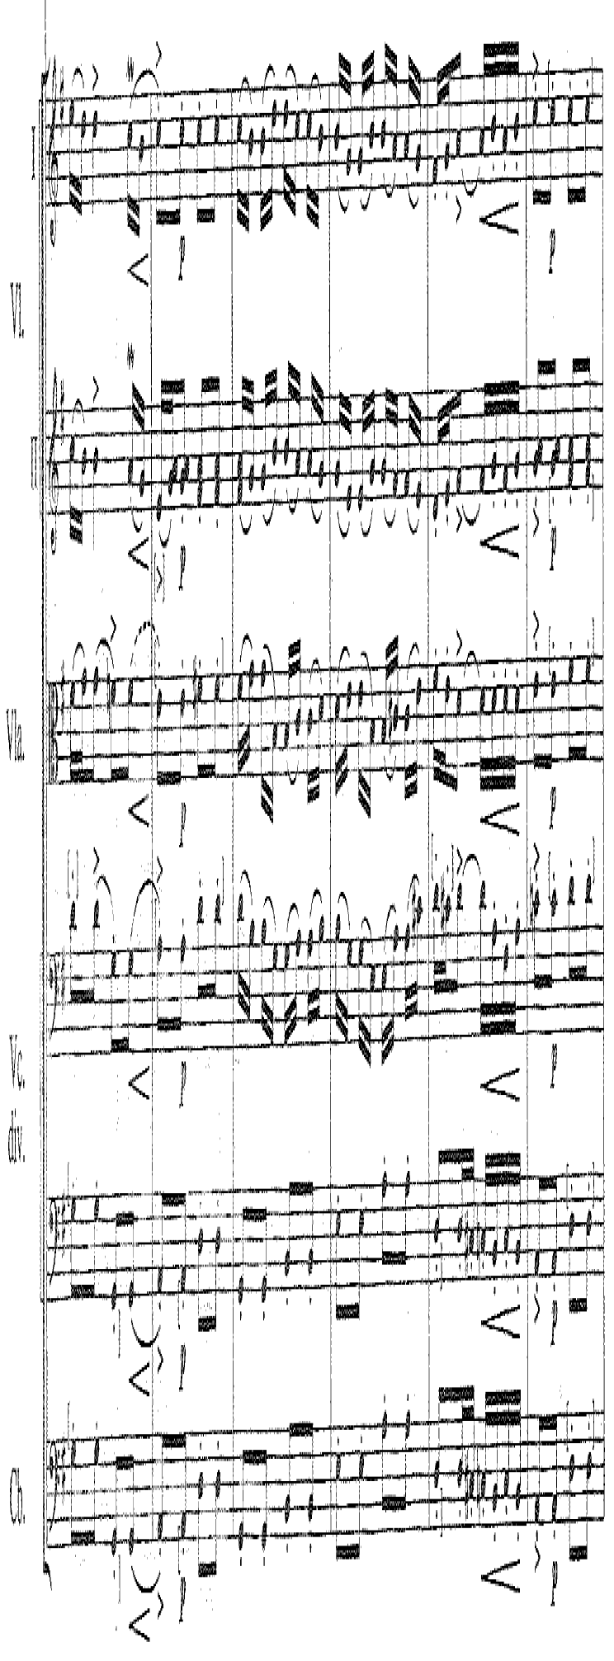
Bryllup i landsbyen
In the ”Village Wedding” the
metre changes to an almost
May-song.
The river is the backdrop and
a bloodline that connects the
composer on an individual level
to his nation’s past, but similarly
connects the listener to a univer-
sal expression of social unity
through a shared cultural heri-
tage.
Kommentér på forholdet mellem
titel og melodisk/rytmisk stil

Slide 7
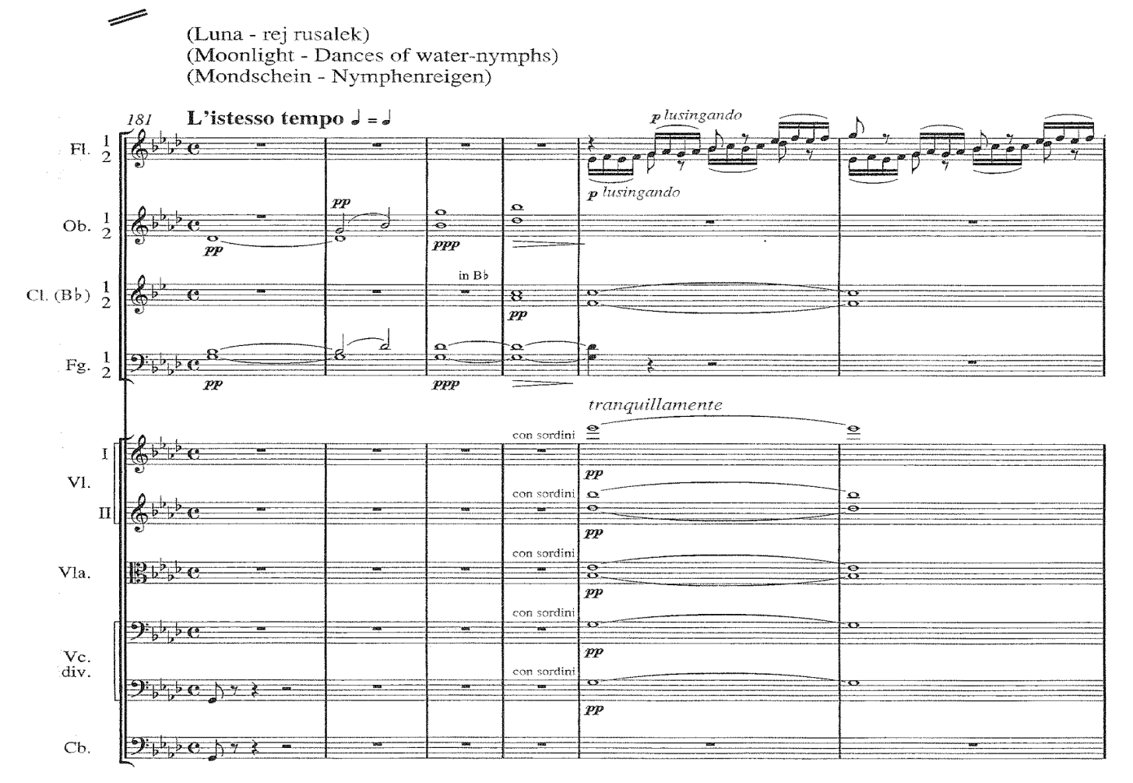
Måneskin –
vand nymfernes dans
A hauntingly sensitive para-
graph of orchestral colours.
Three layers are melded to-
gether here: the agitated
water’s surface in flutes and
clarinets, embraced by a tran-
quil halo of muted divided
strings; the distant brass fan-
fares that emerge from held
chords offer a mysterious back-
ground urgency.
Kommentér på den instrumen-
tale arbejdsdeling
Bemærk den dynamiske udvikling
(se wave)

Slide 8
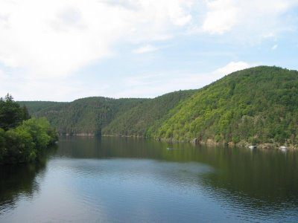
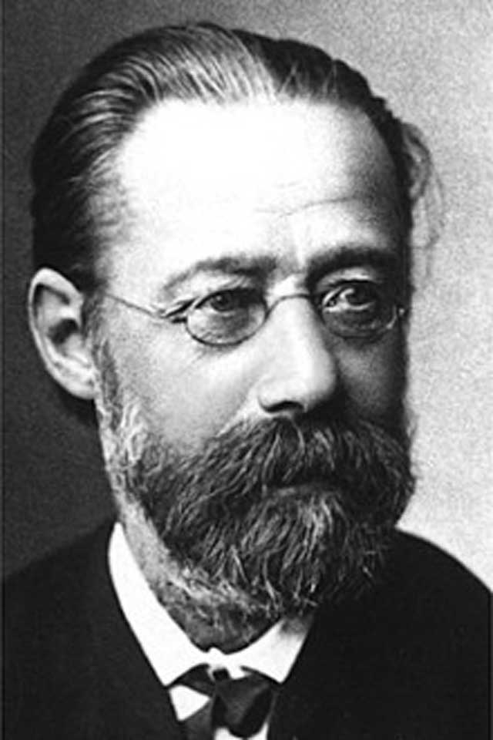
Hovedtema A (reprise)
The river meanders back to the foreground
a recapitulation that leads us smoothly but
deceptively to the abrupt cataract of ….
St.Johann vandfaldene
As the river broadens, we are led inexorably
Back to the Bohemian age of heroes and …
Vysehrad-klippen (reprise i dur!)
… a rocky outcrop of historical and mythological
importance near Prague.
David Lewiston Sharpe
Beskriv de musikalske stemninger ved henh.
vandfaldene og klippen

